Slide 1

Object Oriented Analysis and Design with Java
UE20CS352
Dr. Sudeepa Roy Dey
Department of Computer Science and Engineering

Slide 2

UE20CS352: Object Oriented Analysis and Design with Java
Unit-4
Introduction To Design Patterns

Slide 3
Agenda
The Beginning of Design Patterns
Design Challenges
What is a design pattern?
What is the advantage of knowing/using design patterns?

Slide 4
The Beginning of Patterns
Christopher Alexander, architect
A Pattern Language--Towns, Buildings, Construction
Timeless Way of Building (1979)
“Each pattern describes a problem which occurs over and over again in our environment, and then describes the core of the solution to that problem, in such a way that you can use this solution a million times over, without ever doing it the same way twice.”

Slide 5
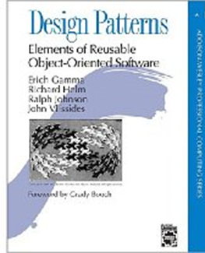
“Gang of Four” (GoF) Book
Design Patterns: Elements of Reusable Object-Oriented Software, Addison-Wesley Publishing Company, 1994 Written by this "gang of four"
Dr. Erich Gamma, then Software Engineer, Taligent, Inc.
Dr. Richard Helm, then Senior Technology Consultant, DMR Group
Dr. Ralph Johnson, then and now at University of Illinois, Computer Science Department
Dr. John Vlissides, then a researcher at IBM

Slide 6
“Gang of Four” (GoF) Book
Design Patterns: Elements of Reusable Object-Oriented Software, Addison-Wesley This book defined 23 patterns in three categories
Creational patterns deal with the process of object creation
Structural patterns, deal primarily with the static composition and structure of classes and objects
Behavioral patterns, which deal primarily with dynamic interaction among classes and objects

Slide 7
Design challenges
Designing software for reuse is hard. One must find:
a good problem decomposition, and the right software
a design with flexibility, modularity and elegance
Designs often emerge from trial and error
Successful designs do exist
two designs they are almost never identical
they exhibit some recurring characteristics
Can designs be described, codified or standardized?
this would short circuit the trial and error phase
produce "better" software faster

Slide 8
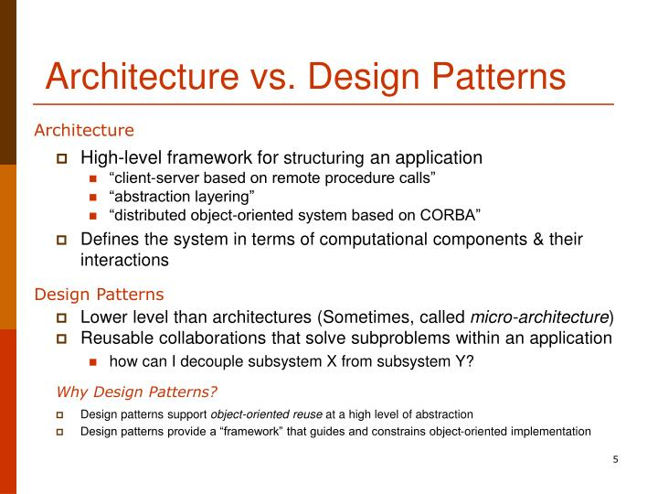
Architecture vs Design Patterns

Slide 9
What are Design Patterns?
Design patterns are used to represent some of the best practices adapted by experienced object-oriented software developers. They are like pre-made blueprints that you can customize to solve a recurring design problem in your code.
Reusable solutions to the problems: In software engineering, a design pattern is general reusable solution to commonly occurring problem in software design.
Interaction between the objects :Object-oriented design patterns typically show relationships and interactions between classes or objects, without specifying final application classes or objects that are involved.
Template, not a solution :It is not a finished design that can be transferred directly into code.
Language independent

Slide 10
What Does a Pattern consists of?
Most patterns are described very formally so people can reproduce them in many contexts. Here are the sections that are usually present in a pattern description:
Intent :of the pattern briefly describes both the problem and the solution.
Motivation: further explains the problem and the solution the pattern makes possible.
Structure of classes: shows each part of the pattern and how they are related.
Code example: in one of the popular programming languages makes it easier to grasp the idea behind the pattern.

Slide 11
Why we should learn Patterns?
Patterns are a common design vocabulary
Allows engineers to abstract a problem and talk about that abstraction in isolation from its implementation
Embodies a culture; domain-specific patterns increase design speed
Patterns capture design expertise and allow that expertise to be communicated
promotes design reuse and avoid mistakes
Improve documentation (less is needed) and understandability (patterns are described well once)

Slide 12
Pros of Design Patterns
Pros
Add consistency to designs by solving similar problems the same way, independent of language
Add clarity to design and design communication by enabling a common vocabulary
Improve time to solution by providing templates which serve as foundations for good design
Improve reuse through composition

Slide 13
Cons of Design Patterns
Cons
Some patterns come with negative consequences (i.e. object proliferation, performance hits, additional layers)
Consequences are subjective depending on concrete scenarios
Patterns are subject to different interpretations, misinterpretations, and philosophies
Patterns can be overused and abused--🡪 Anti-Patterns

Slide 14
References
https://sourcemaking.com/design_patterns/
https://refactoring.guru/design-patterns/java
Design Patterns: Elements of Reusable Object-Oriented SoftwareErich Gamma, ‎Ralph Johnson, ‎Richard Helm · 1995

Slide 15
THANK YOU
Dr. Sudeepa Roy Dey and Dr Geetha D
Department of Computer Science and Engineering

